Slide 1
All Systems Go!
Python with Robots Mission 9
Lesson 3 Objectives 8-12

Slide 2

Pre-Mission Warm-Up
In your Mission 9 Lesson 3 log, answer the pre-mission warm-up question:
What do you know about gravity?
What are the three dimensions in our world?

Slide 3

Mission 9: All Systems Go!
In this mission you’ll get to know CodeBot’s internal system sensors.
Your ‘bot can measure its own battery voltage and CPU temperature.
And it can sense its orientation as well as impacts and vibration with the accelerometer.
Ah yes, CodeBot is self-aware!

Slide 4
Mission 9: All Systems Go!
For this lesson, we will work on the last two goals:
Detect orientation with the CodeBot accelerometer and rotate toward the sky.
Make a motion alarm “guard robot.”
Robot, know thyself!

Slide 5
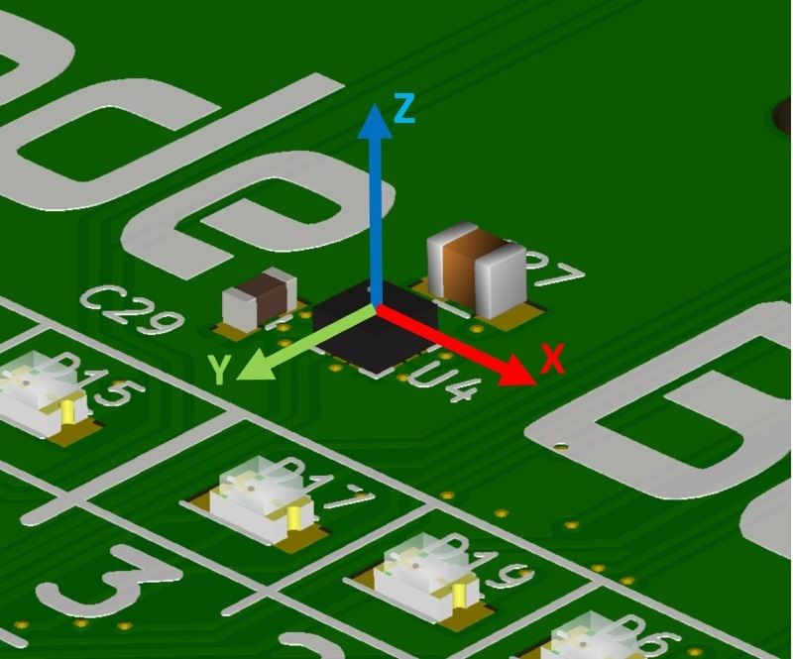
Objective #8: Accelerometer
CodeBot has an accelerometer, which is the tiny chip shown in the image.
It can detect impacts with other objects, changes in motion, and orientation.
The accelerometer measures the force of acceleration in 3 directions:
X (side to side)
Y (front to back)
Z (up and down)

Slide 6
Objective #8: Accelerometer
The CodeBot accelerometer is a MEMS accelerometer.
MEMS stands for “Micro-Electro-Mechanical System”
Inside this little chip are tiny silicon structures that really move!
And, of course, electronic components to sense them.

Slide 7
Objective #8: Accelerometer
The botcore library includes functions that let you access data from the accelerometer.
Two of the functions are:
accel.dump_axes()
This function prints the 3-axis values to the console.
accel.read()
This function reads the current axis values and returns a tuple of integers.
The integers range from -32767 to +32768.
The top and bottom values represent 2gs (gravity)

Slide 8
Objective #8: Accelerometer
Pulling some g’s!
Let’s talk about gravity.
Let’s use the image as an example.
If the circuit board is positioned flat (horizontal) and motionless on Earth, it will have 1g pulling down in the -Z direction.
In physics, the letter g means Earth’s gravitational acceleration, which is approximately 9.8m/s².

Slide 9
Objective #8: Accelerometer
So if the circuit board is positioned flat (horizontal) and motionless, you would expect the accelerometer to give these measurements:
X = 0g (pointed toward the horizon, no acceleration)
Y = 0g (same as x, no acceleration)
Z = -1g (Earth’s gravity pulling straight down, opposite the +Z direction)

Slide 10
Objective #8: Accelerometer
But wait!
The read() function returns integers between -32767 and +32768 (which is 2¹⁵)
-32767 is -2g
+32768 is +2g
So -1g is -16383 (Earth’s gravity pulling straight down)
Write some code to test the Z = -16383 theory.

Slide 11
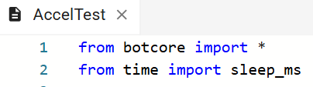
Objective #8 Activity
DO THIS:
Start a new file called AccelTest.
Import the botcore library.
Import sleep_ms (not sleep) from the time library.

Slide 12
Objective #8 Activity
DO THIS:
Use a while True loop to:
Print the 3-axis values to the console using accel.dump_axes()
Sleep for 200 ms
Try doing the code on your own.

Slide 13
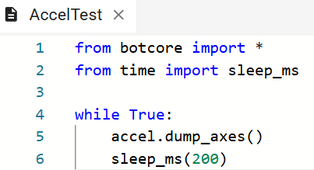
Objective #8 Activity Code

Slide 14
Objective #8 Activity
DO THIS:
Place CodeBot on a flat surface, like your desk.
Open the console panel.
Run the program.
Observe the accelerometer measurements.
Is it what you expected? How flat is your surface?
Place CodeBot in different positions and record the measurements in the mission log’s table.

Slide 15
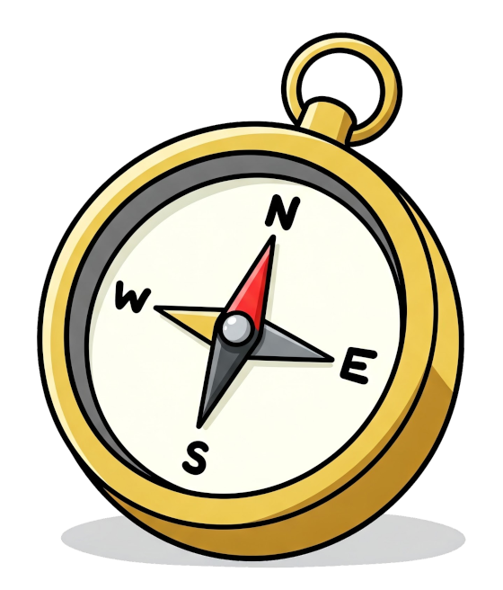
Objective #9: Reach for the Stars
One way to use the accelerometer is for navigation.
You can track your bot’s orientation very precisely.
You can use this knowledge to create a balancing vehicle or a quadcopter drone.
But start with something simple.

Slide 16
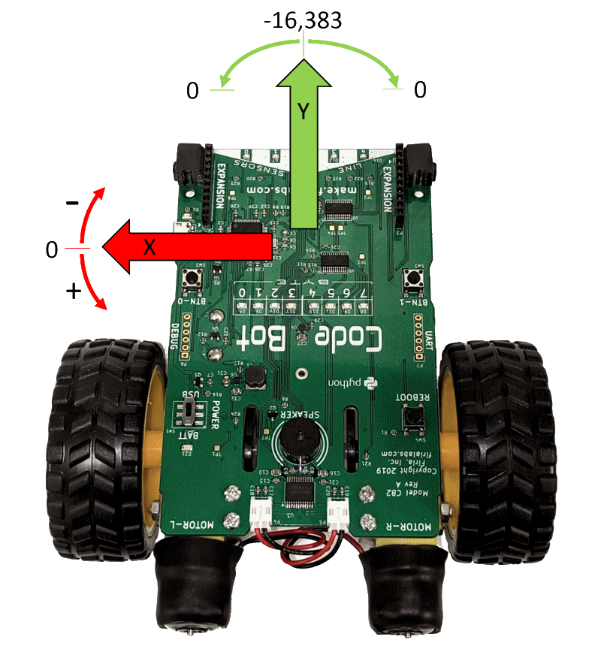
Objective #9: Reach for the Stars
Rotate to face skyward!
Your challenge is to monitor CodeBot’s orientation.
Use the measurements to control the motors to keep the nose pointed up at all time.

Slide 17
Objective #9: Reach for the Stars
Take a look at the image, with the bot oriented vertically.
You need to rotate the bot until Y is negative and X is near zero.
A Y value close to -16383 would be pointing straight up.
But Y is negative over a wide range.

Slide 18
Objective #9: Reach for the Stars
Maybe you can use just the X-axis to determine rotation direction?
If X is negative, rotate counter-clockwise.
If X is positive, rotate clockwise.

Slide 19
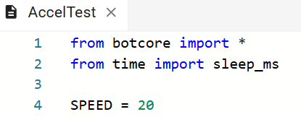
Objective #9 Activity
DO THIS:
Modify your code.
Delete the code below the import statements.
Define a constant for SPEED
Start with a slow speed!

Slide 20
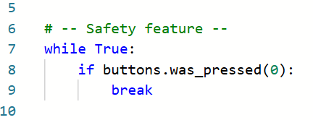
Objective #9 Activity
DO THIS:
This program involves movement.
Use your safety feature from Mission 4.

Slide 21
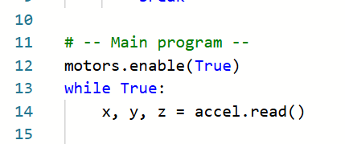
Objective #9 Activity
DO THIS:
Start the main program.
Enable the motors.
Read the accelerometer. It returns three values!

Slide 22
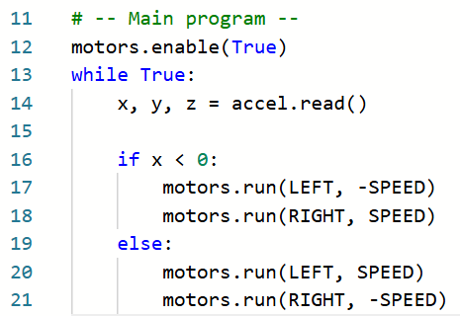
Objective #9 Activity
DO THIS:
Use the X value to determine rotation.

Slide 23
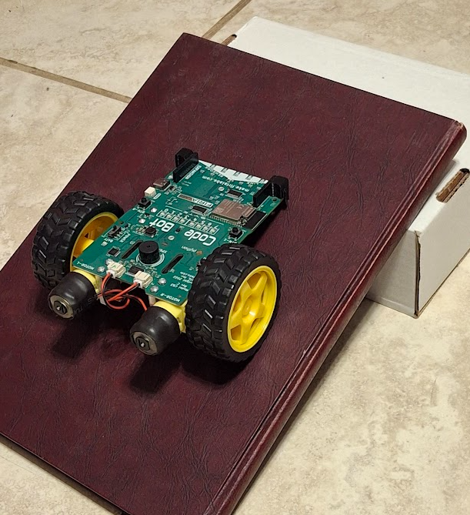
Objective #9 Activity
DO THIS:
Test the code on an inclined surface. You can use a large book, cardboard, or anything sturdy.
Prop one end up so the surface is at an incline.

Slide 24
Objective #9 Activity
DO THIS:
Run the code with BATT power.
Place CodeBot on the inclined surface.
Press BTN-0 to run the main program.
What happens? Does the nose of the robot point toward the top of the surface?
Record the result in the mission log.

Slide 25

Objective #10: Upgrade!
Okay, this code needs some work.
When you face a new coding challenge, often the best approach is “The simplest thing that could possibly work.”
Many times you’ll find the simple solution works great.
And when it doesn’t, you learn something!

Slide 26
Objective #10: Upgrade!
In this case you’ve learned that CodeBot will continuously overshoot the top position.
It oscillates back and forth.
Not what you wanted!
So this simple solution needs improvement.
There are a lot of ways to code this. You can experiment on your own.
Here is one way to improve the program.

Slide 27
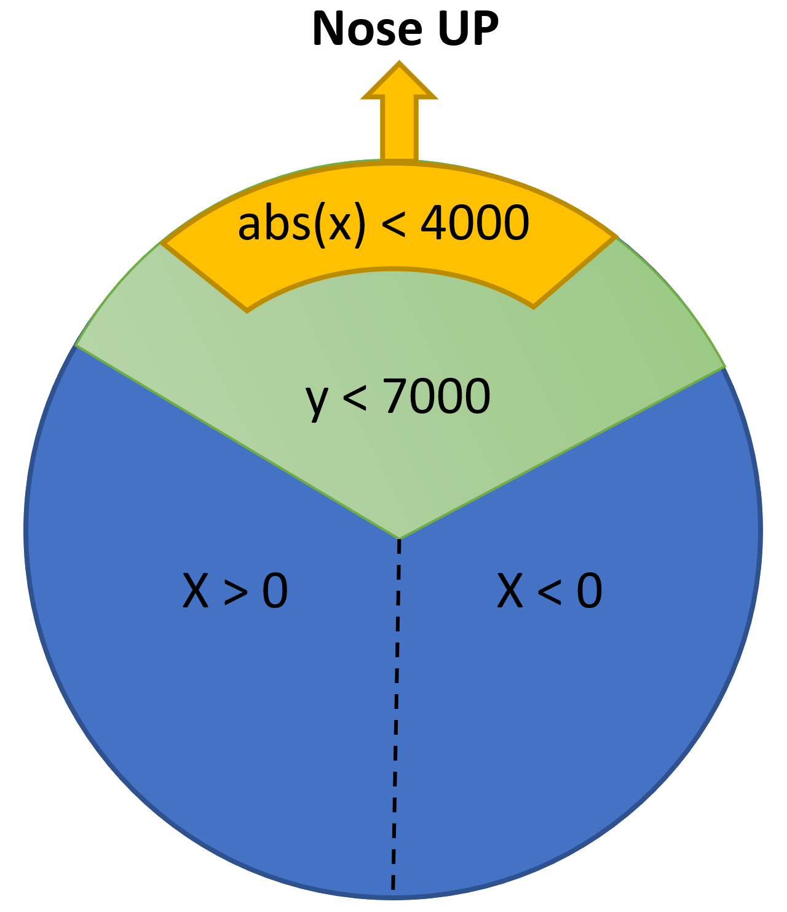
Objective #10: Face Skyward Algorithm
Use the diagram to think about how the X and Y values vary when CodeBot rotates on an incline.
Review the data from the table for Obj. 8.
The Y-axis is around 7000 when it is sitting on your desk, nose pointed slightly down.
We will use this value as “level”.
The range of abs(x) < 4000 is an approximate zone where you want to slow down rotation.
Remember: abs() means absolute value. With abs(x) < 4000, x will be between -3999 and +3999

Slide 28

Objective #10 Activity
DO THIS:
Increase the SPEED

Slide 29
Objective #10 Activity
DO THIS:
Modify the if statement in the main program to include a slow down proportional to the X value near the top.
It will calculate a rotation speed (rot_spd) for controlling the motors.
Use the rot_spd variable for the speed instead of SPEED.

Slide 30
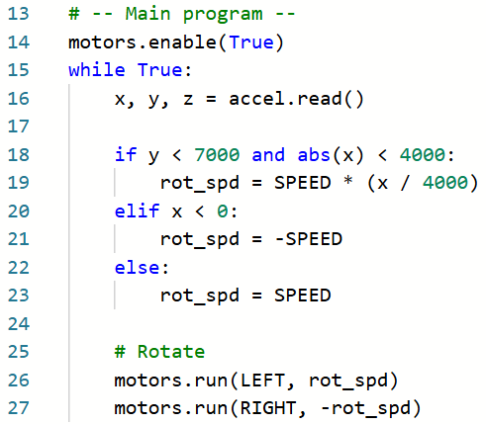
Objective #10 Activity Code

Slide 31
Objective #10 Activity
DO THIS:
Run the code with BATT power.
Place CodeBot on the inclined surface.
Press BTN-0 to run the main program.
What happens? Does the nose of the robot point towards the top of the surface?
Tilt the surface in many directions.
Record the result in the mission log.

Slide 32

Mission quiz
Now …. time for a quiz!
Answer the four quiz questions in CodeSpace.
CODEX
QUIZ

Slide 33

Objective #11 Guard Bot
Powerful and sensitive!
Prepare to be amazed at the capabilities of the CodeBot accelerometer.
Ready to pounce at the slightest movement!
There are quite a few advanced capabilities built into the hardware of this device.
It can detect motion based on programmable thresholds for any of its 3-axes.

Slide 34
Objective #11 Guard Bot Algorithm
Your new challenge is to combine your accelerometer knowledge with Python code to create a sensitive motion detector.
Sample the accelerometer with accel.read().
Start an infinite loop.
Wait a small amount of time.
Sample the accelerometer again.
Compare the values from the previous read() to the current one.
If there is a significant difference, sound the alarm!

Slide 35
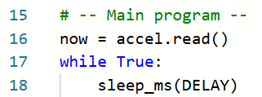
Objective #11 Guard Bot Algorithm
Take a look at each step.
Sample the accelerometer with accel.read().
Start a while True loop.
Wait a small amount of time.
Use a constant for the DELAY.
This makes it easier to adjust the delay as needed.

Slide 36
Objective #11 Guard Bot Algorithm
4. Sample the accelerometer again.
5. Compare the current read() to the previous one.
One way to compare the current with the previous is to use two variables
now = accel.read() returns a tuple with three integers.
before = now assigns the same tuple to the variable before
now = accel.read() returns a new tuple
Compare the difference of the two

Slide 37

Objective #11 Guard Bot Algorithm
4. Sample the accelerometer again.
5. Compare the current read() to the previous one.
The X reading is the first item in the tuple.
That means the index is 0.
Use now[0] and before[0]
Assign the variable dx the difference.

Slide 38

Objective #11 Guard Bot Algorithm
6. If there is a significant difference in X, sound the alarm!
The sensitivity is the amount of change in X that should trigger an alarm. This will be a constant.
When comparing the two readings, you want to know if the difference dx is more than the sensitivity.
X can be positive or negative, so you need two comparisons:
if dx < -SENS or dx > SENS:
You can simplify by using absolute value:

Slide 39
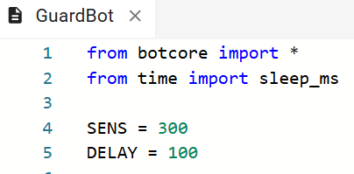
Objective #11 Activity
DO THIS:
Start a new file called GuardBot.
Import the libraries needed.
Define constants for SENS and DELAY.

Slide 40
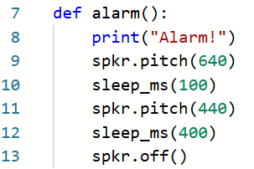
Objective #11 Activity
DO THIS:
Define a function for the alarm.
Use spkr.pitch(), sleep_ms() and spkr.off().
You can make the alarm the way you want it. Here is an example:

Slide 41
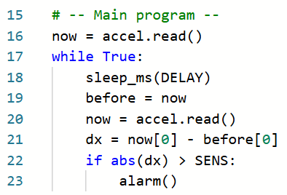
Objective #11 Activity
DO THIS:
Write code for the main program by following the steps in the algorithm.

Slide 42
Objective #11 Activity
DO THIS:
Place CodeBot on a flat stable surface.
Run the code. You can open the console panel if you want to see the “Alarm!” printed.
Jiggle the ‘bot a little bit to set off the alarm.
Adjust the values for SENS and DELAY until you get the alarm just the way you want it.

Slide 43
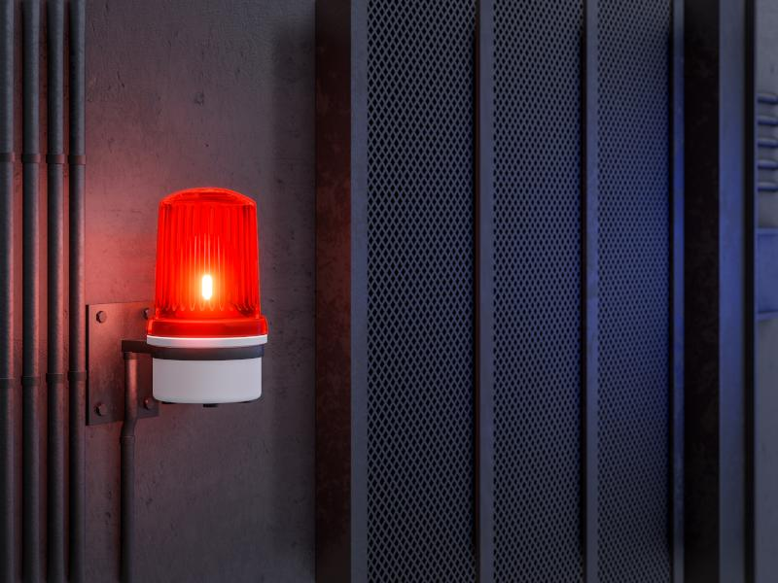
Objective #12 Guard Bot 2: Guard Harder
Detecting on all 3 axes
Your program is great at detecting movement on the X-axis.
What if someone were to carefully whisk you ‘bot away while keeping the wheels level?
The alarm wouldn’t sound!
You can fix that gap by detecting movement on all 3 axes!
X, Y and Z

Slide 44
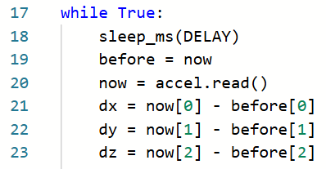
Objective #12 Activity
DO THIS:
Add code to the find the difference between the Y-axis and Z-axis.

Slide 45
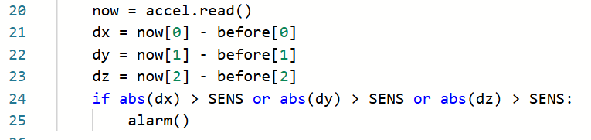
Objective #12 Activity
DO THIS:
Modify the if statement to check all three dimensions.

Slide 46
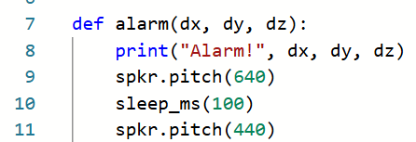
Objective #12 Activity
DO THIS:
Make one more change.
You can print the changes in x, y and z when you sound the alarm.

Slide 47
Objective #12 Activity
DO THIS:
Don’t forget to add the arguments in the alarm() function call!

Slide 48
Objective #12 Activity
DO THIS:
Place CodeBot on a flat stable surface.
Run the code.
Open the console panel if you want to see the “Alarm!” and differences printed.
Jiggle the ‘bot a little bit to set off the alarm.
Try different movements, like up/down, left/right and forward/backward.
Adjust the values for SENS and DELAY until you get the alarm just the way you want it.

Slide 49

Extension - medium
Fall Detector: Use the accelerometer to detect if your ‘bot is falling. Make CodeBot “scream” when it falls.
CLUE: When you are in a free-fall (or outer space), it is nearly zero-g in all 3-axes.

Slide 50
Extension – spicy
Bump-Bot: Move forward until you detect an impact. Then rotate a random amount and go again!
Not graceful… but fun!

Slide 51
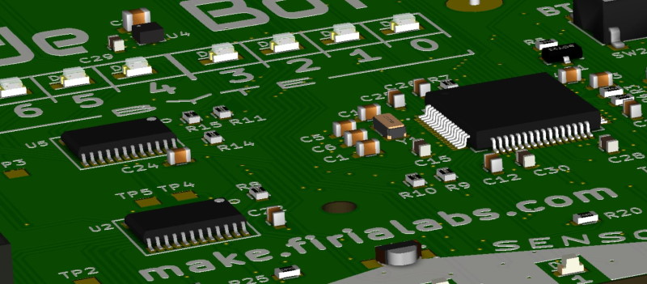
Post-Mission 9: All Systems Go!
You’ve examined many of your bot’s subsystems:
Battery health will no longer be a mystery to you.
You can sense if things are starting to heat up… or get chilly.
Your code can behave differently based on orientation.
And respond instantly to even the slightest movement.

Slide 52
Post-Mission 9: All Systems Go!
You already use this kind of code daily!
Your phone tracks and displays its battery usage.
Electronic thermostats control temperature in most buildings.
Accelerometers are used in everything from smart-watches to game-controllers.
Now you are in the game. Code On!

Slide 53
Post-Mission Reflection
Complete the post-mission reflection in your Mission 9 Lesson 3 Log:
What everyday items do you use that might have an accelerometer? How is the accelerometer used?
Think back to when you first started programming. How have you changed as a programmer?

